Slide 1
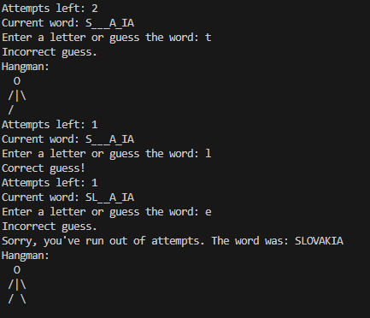
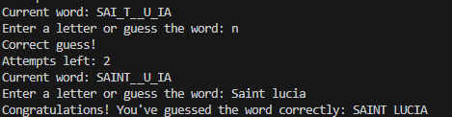
GlobeGuesser - Geography Hangman Game by Jack Cramer
Test your knowledge of the globe!

